Slide 1

Varuvan vadivelan institute of technology
HEART DISEASE PREDICTION
USING
MACHINE LEARNING
TEAM MEMBERS :
612819104019 – MANIKANDAN .D
612819104024 – NAVEEN KUMAR .S.K
612819104052 – SURYA .T
612819104053 – THAMIZ .N
GUIDED BY :
Mrs. R.S.Archana Vishveswari,
Asst. Professor (CSE)

Slide 2
ABSTRACT
MACHINE LEARNING, which is one of the most prominent applications of Artificial Intelligence, is doing wonders in the research field of study. In this project machine learning is used in detecting if a person has a HEART DISEASE OR NOT. A lot of people suffer from cardiovascular diseases (CVDs), which even cost people their lives all around the world.
Machine learning can be used to detect whether a person is suffering from a cardiovascular disease by considering certain attributes like chest pain, cholesterol level, age of the person and some other attributes. Classification algorithms based on machine learning can make diagnoses of cardiovascular diseases easy.
Algorithms like K-Nearest Neighbor (KNN), Random Forest are used to classify people who have a heart disease from people who do not. Two machine learning algorithms are used in this project which are, K-Nearest Neighbor (K-NN) and Random Forest. The prediction accuracy obtained by K-Nearest Neighbor (K-NN) is 86.885% and the prediction accuracy obtained by Random Forest algorithm is 81.967%.

Slide 3
Existing system
In Existing System there are used only Naive Bayes(NB) algorithm for classification.
Naive Bayes classification algorithm is Probablistic classifier. It is based on probability models that incorporates strong independent assumptions, which often don’t have impact on reality
so, we can’t determine Naive Bayes(NB) is optimal. Because of, the remaining algorithms maybe perform well than Naive Bayes (NB)

Slide 4
Proposed system
The proposed work predicts heart disease by exploring the below mentioned two classification algorithms and does performance analysis.
K-Nearest Neighbor (K-NN):
In K-NN algorithm a data point is taken whose classification is not available, then the number of neighbors, k is defined. After that k neighbors are selected according to the lowest Euclidian distance between the selected data points and their neighbors. The selected data point is then classified into a category, which is same as the category which has majority of neighbors among the K neighbors

Slide 5
Randomforest Random forest works by constructing multiple decision trees of the training data. each of the trees predicts a class as an output and the class, which is the output of the greatest number of decision trees is taken as the final result, in case of classification. In this algorithm we need to define the number of trees we want to create. Random forest is a bootstrap aggregating or bagging technique. This technique is used to decrease the variance in the result The objective of this study is to effectively predict if the patient suffers from heart disease. The health professional enters the input values from the patient's health report. The data is fed into model which predicts the probability of having heart disease

Slide 6
SYSTEM REQUIREMENTS
SOFTWARE REQUIRED :
HARDWARE REQUIRED :
CODING LANGUAGE :
PROCESSOR :
Python
Intel i3 2.4GHz
RAM :
OPERATING SYSTEM :
4 GB RAM
Windows OS
HARD DISK :
512 GB

Slide 7
Architectural Diagram
Input Data
Data preprocessing
Trained model
Graphical user interface
OUTPUT
Graphical user
interface
Algorithms
User INPUT

Slide 8
mODULES
LIBRARY MODULES :
SYSTEM MODULES :
Numpy
User interface module
Matplotlib
Training module
Pandas
Testing module
Scikit-learn

Slide 9
LIBRARY MODULES
NUMPY :
Numpy stands for “Numerical Python” which is used to perform Mathematical and Logical Operations over an Array.
E.g: array.mean() , array.sum()
MATPLOTLIB :
It is extension of NUMPY and used to “Visualize the Data” through plotting it.
E.g: Pie Chart , Bar Chart.

Slide 10
PANDAS :
It is advanced version of Matplotlib and is used to Visualize and Preprocessing the data
E.g: Drop Missing Values in Dataframe
SCIKIT-LEARN :
It contains Predefined Machine Learning Algorithms which is used to Train the Model.
E.g: K-Nearest Neighbor(KNN), Random Forest (RF)

Slide 11

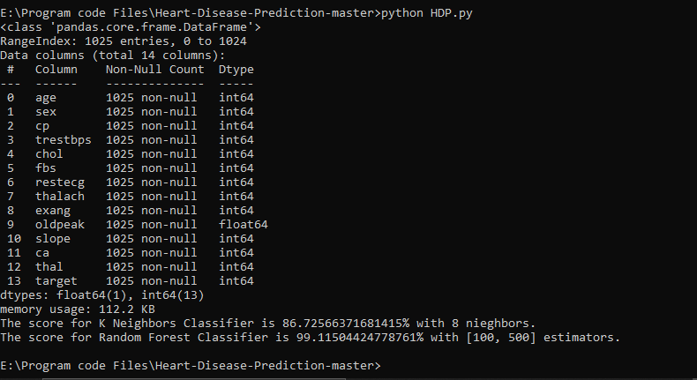
Sample output

Slide 12
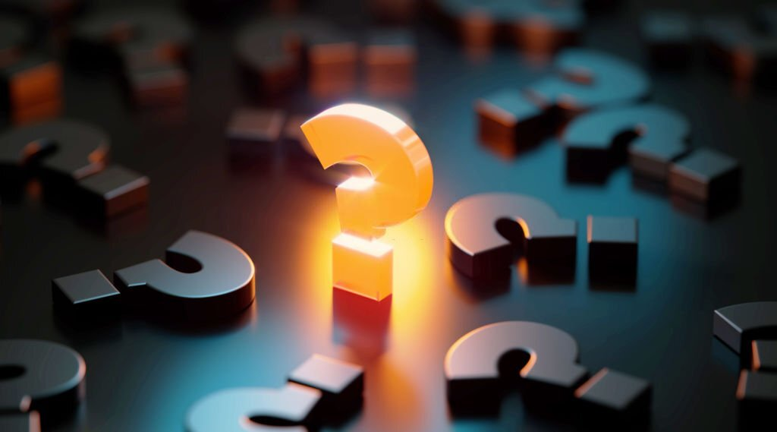
Thank you...😊

